Slide 1
Revision: Evaluation
Statement for Audio and Video Learning Resources
Video and audio content at the University uses closed captions generated by automatic speech recognition (ASR). The ASR process is based on machine learning algorithms which automatically transcribe voice to text. According to our technology providers, this process is approximately 70-90% accurate depending on the quality of the audio, and consequently video and audio closed captions may include some transcription errors. It is therefore important to recognise that the original recording is the most accurate reflection of the content, and not the captions.
If you require accurate captions as part of your reasonable adjustments, please contact the Inclusion Centre to discuss your requirements.

Slide 2
Contents
Predictive model evaluation
Classification metrics
Experimental design
Clustering evaluation
Association rules evaluation

Slide 3
Model evaluation
Modelling: use a ML algorithm on a dataset to produce a (predictive) model.
A model needs to be evaluated.
The results of using a predictive model can be:
A class: may be
Class output: can be converted to probabilities (controversial!)
Probability output: logistic regression, random forest , gradient boosting. A class is selected according to the probability outputs.
A numeric prediction.

Slide 4
Training and Testing
Resubstitution error
Error rate from training data.
Hopelessly optimistic!
Over-fitting of data
Solution: Split data into training and testing set.
Test set
Independent instances that play no part in learning of classifier.
Assumption: training and test data are representative samples of the underlying problem.
What evaluation measures? Depends on whether prediction is a class or a numeric value.

Slide 5
Evaluation measures: class prediction
Confusion matrix
Evaluation metric
Accuracy / Error
Precision and Recall
F1 measure
Sensitivity
Specificity
Kappa statistics
ROC curves / AUC

Slide 6
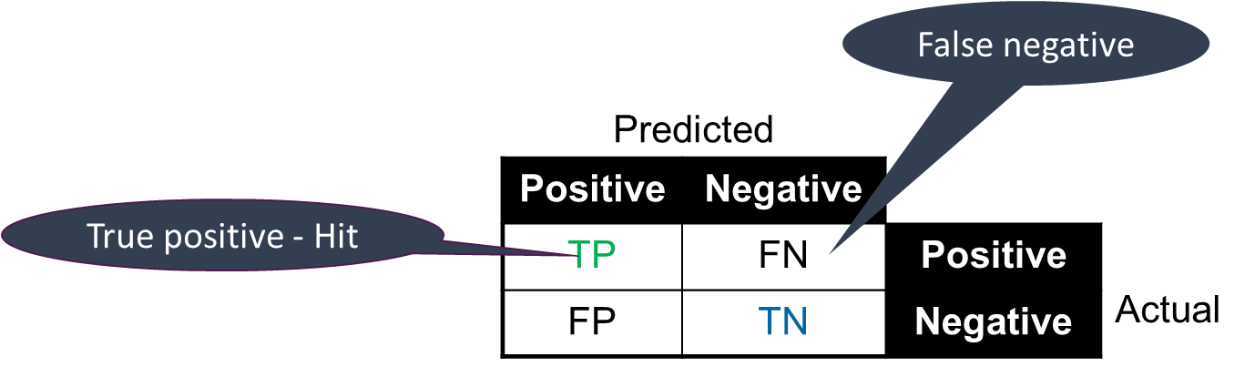
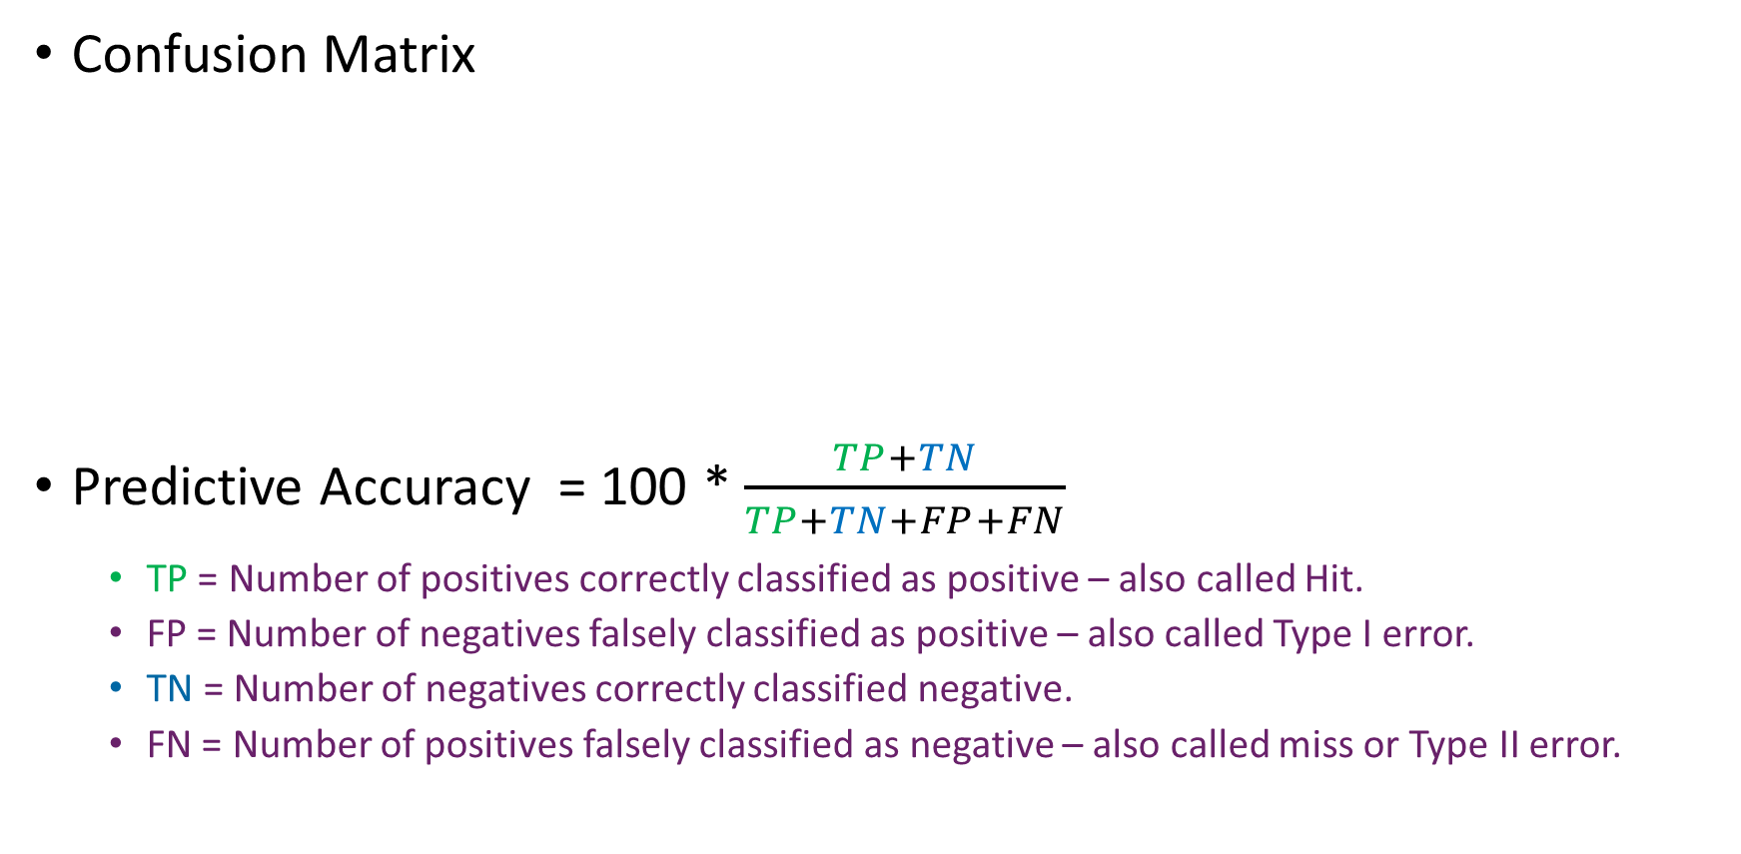
Confusion matrix - binary classification
Confusion Matrix
Predictive Accuracy = 100 * $\frac{TP+TN}{TP+TN+FP+FN}$
TP = Number of positives correctly classified as positive – also called Hit.
FP = Number of negatives falsely classified as positive – also called Type I error.
TN = Number of negatives correctly classified negative.
FN = Number of positives falsely classified as negative – also called miss or Type II error.

Slide 7
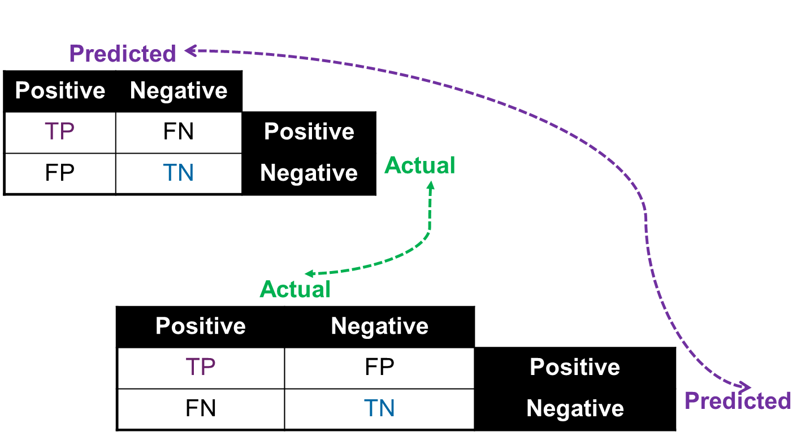
Confusion matrix – 2 options
For any confusion matrix, either columns or rows correspond to predicted. The other option corresponds to actual.

Slide 8

Accuracy
Measures the proportion of predictions which are correct.
Regardless of the class
Used widely
Sometimes error used instead.
Error = 1 – accuracy.
Can be extremely problematic when used with imbalanced datasets, i.e. datasets where one class dominates.

Slide 9
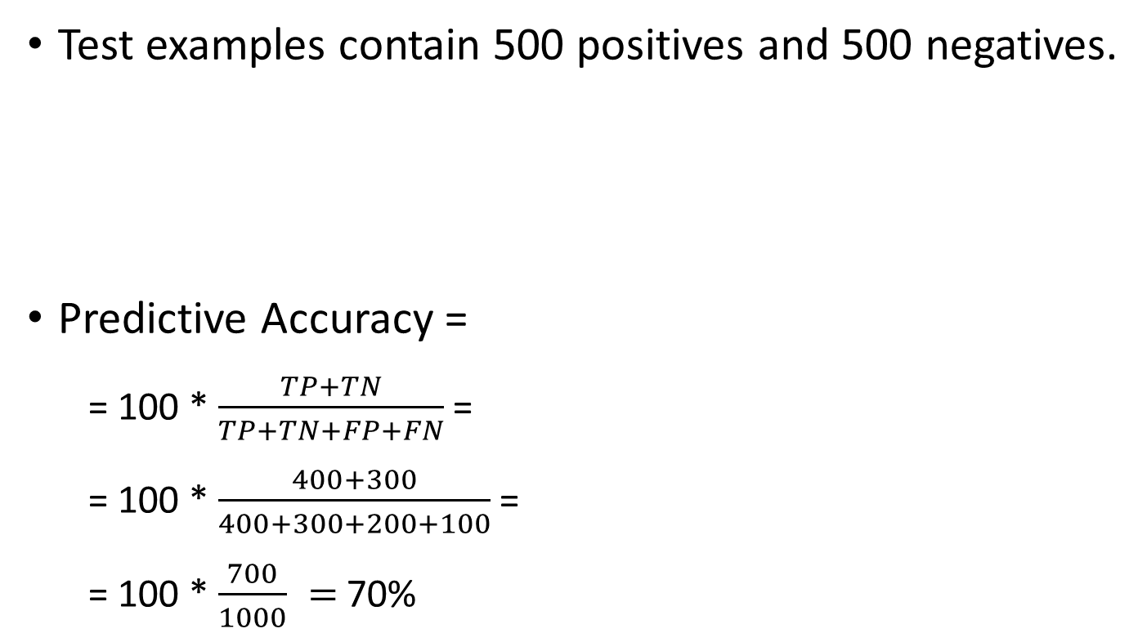
Accuracy example – binary classification
Test examples contain 500 positives and 500 negatives.
Predictive Accuracy =
= 100 * $\frac{TP+TN}{TP+TN+FP+FN}$=
= 100 * $\frac{400+300}{400+300+200+100}$=
= 100 * $\frac{700}{1000} =$70%
Predicted
Positive | Negative
400 | 100 | Positive | Actual
200 | 300 | Negative

Slide 10
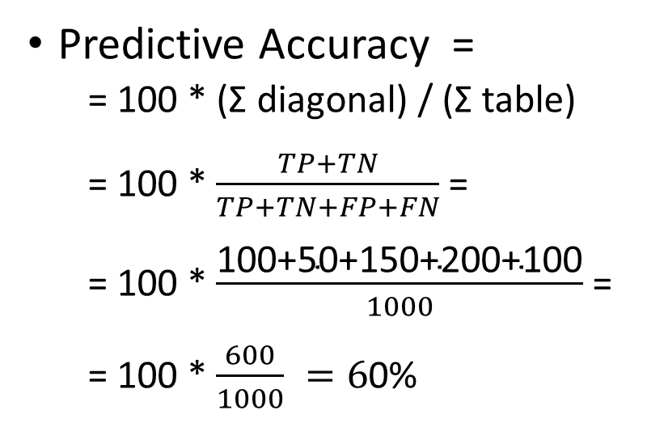
Accuracy – non-binary classification
Predicted
a | b | c | d | e
100 | 60 | 0 | 40 | 0 | a
30 | 50 | 30 | 30 | 60 | b
20 | 0 | 150 | 0 | 30 | c | Actual
0 | 0 | 0 | 200 | 0 | d
0 | 50 | 0 | 50 | 100 | e
Predictive Accuracy =
= 100 * (Σ diagonal) / (Σ table)
= 100 * $\frac{TP+TN}{TP+TN+FP+FN}$=
= 100 * $\frac{\text{100+50+150+200+100}}{1000}$=
= 100 * $\frac{600}{1000} =6$0%
Σ means “sum”

Slide 11
Precision and Recall
TP Rate FP Rate Precision Recall F-Measure MCC ROC Area PRC Area Class
0.700 0.243 0.609 0.700 0.651 0.444 0.695 0.559 bad
0.757 0.300 0.824 0.757 0.789 0.444 0.695 0.738 good
WA. 0.737 0.280 0.748 0.737 0.740 0.444 0.695 ` 0.675
a b <-- classified as
14 6 | a = bad
9 28 | b = good
Weighted average
Measures are per class value
Precision: Fraction of returned as class X that are really class X
E.g precision(“bad”) =14/23 = 0.609
Recall: fraction of all class X which are returned as class X.
E.g recall(“bad”) = 14/20 = 0.7

Slide 12
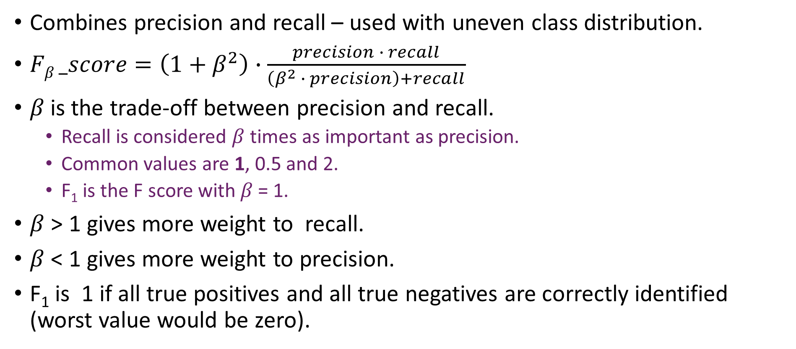
F-score or F-measure
Combines precision and recall – used with uneven class distribution.
$Fβ _score=\left(1+β^{2}\right)∙\frac{precision ∙ recall}{\left(β^{2} ∙ precision\right)+recall}$
$β$is the trade-off between precision and recall.
Recall is considered $β$ times as important as precision.
Common values are 1, 0.5 and 2.
F₁ is the F score with 𝛽 = 1.
$β$ > 1 gives more weight to recall.
$β$ < 1 gives more weight to precision.
F₁ is 1 if all true positives and all true negatives are correctly identified (worst value would be zero).

Slide 13
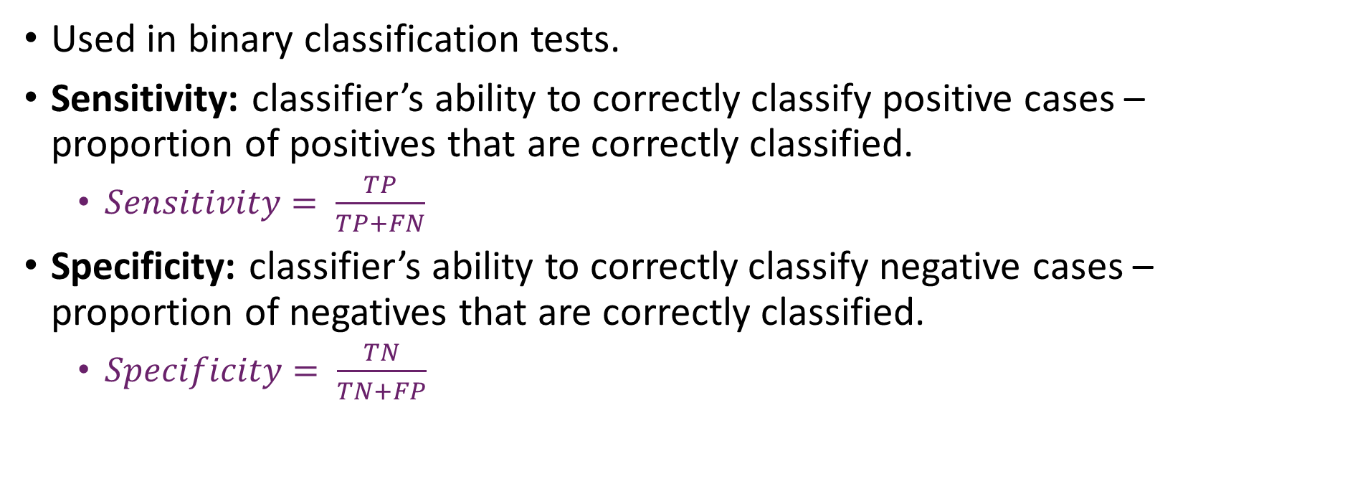
Sensitivity and specificity
Used in binary classification tests.
Sensitivity: classifier’s ability to correctly classify positive cases – proportion of positives that are correctly classified.
$Sensitivity= \frac{TP}{TP+FN}$
Specificity: classifier’s ability to correctly classify negative cases – proportion of negatives that are correctly classified.
$Specificity= \frac{TN}{TN+FP}$

Slide 14
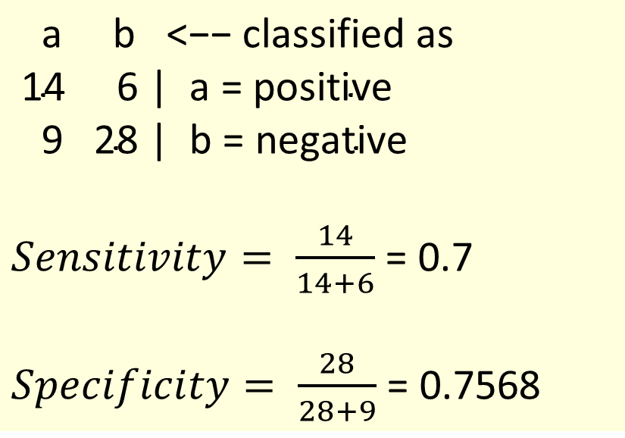
Sensitivity and Specificity (binary classification)
$\text{a} \text{b}\text{ <−− }\text{classified} \text{as}$
$\text{14 6 | }\text{a}\text{ = }\text{positive}$
$\text{9 28 | }\text{b}\text{ = }\text{negative}$
$Sensitivity= \frac{14}{14+6}$ = 0.7
$Specificity= \frac{28}{28+9}$ = 0.7568

Slide 15
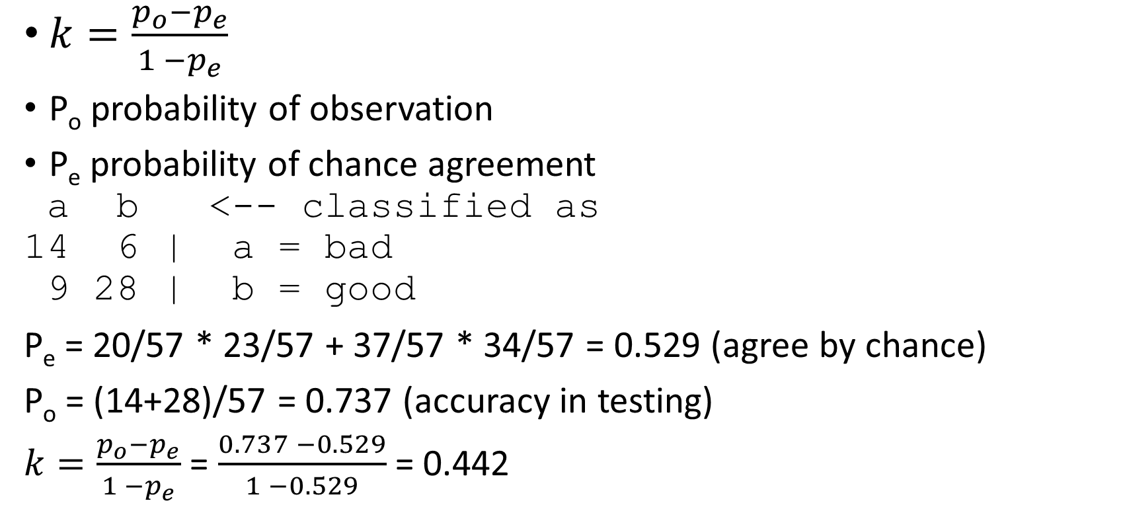
Kappa (inter-related agreement – nominal class)
$k=\frac{p_{o}−p_{e}}{1 −p_{e}}$
P_{o} probability of observation
P_{e} probability of chance agreement
a b <-- classified as
14 6 | a = bad
9 28 | b = good
P_{e} = 20/57 * 23/57 + 37/57 * 34/57 = 0.529 (agree by chance)
P_{o} = (14+28)/57 = 0.737 (accuracy in testing)
$k=\frac{p_{o}−p_{e}}{1 −p_{e}}$ = $\frac{0.737 −0.529}{1 −0.529}$ = 0.442
Actual:
14 + 6 = 20 bad
9+28= 37 good
Classified as:
14+9 = 23 bad
6 + 28 = 34 good
Total = 14+6+9+28 = 57

Slide 16
Kappa
Takes into account chance agreement.
Interpretation:
Little agreement: k < 0.20
Some agreement: 0.20 ≤ k < 0.40
Moderate agreement: 0.40 ≤ k < 0.60
Good agreement: 0.60 ≤ k < 0.80
Very good agreement: 0.80 ≤ k < 1.00

Slide 17
Contents
Predictive model evaluation
Classification metrics
Experimental design
Clustering evaluation
Association rules evaluation

Slide 18
Experimental design
Design experiments to build and evaluate model.
Consider bias vs. variance trade-off.
Consider dataset imbalance – dataset where one type of target scenario is much more represented than another one.
Lots of data required! Need data to
Tune models
Optimise parameter values
Need training and testing sets
Test final model
Need additional testing set.

Slide 19
Making the most of data
Need data to
Tune models
Dataset divided into
Training set: to build the models with different parameter values
Test set: to test the model built with specific parameter settings
Once testing is completed model is built with all the data.
Methods below refer to this tuning - testing
Additional test set required
To test the final model, once the tuning has been optimised.

Slide 20
Utilising the Available Data
Holdout procedure
Holdout certain amount of data for testing
use remainder for training
one third for testing (2), the rest for training (1)
Dilemma
the larger the training data the better the classifier
the larger the test data the more accurate the error estimate
After evaluation
all data may be used to build final classifier

Slide 21
Holdout Evaluation
Samples should be representative
Each class is represented with approximately equal proportions in both subsets
This is called stratified hold-out
Repeated holdout
Randomly select test set each iteration
Calculate average metric (e.g. error)
Can overlapping test sets be avoided?
Exploit test-train splits, but…

Slide 22
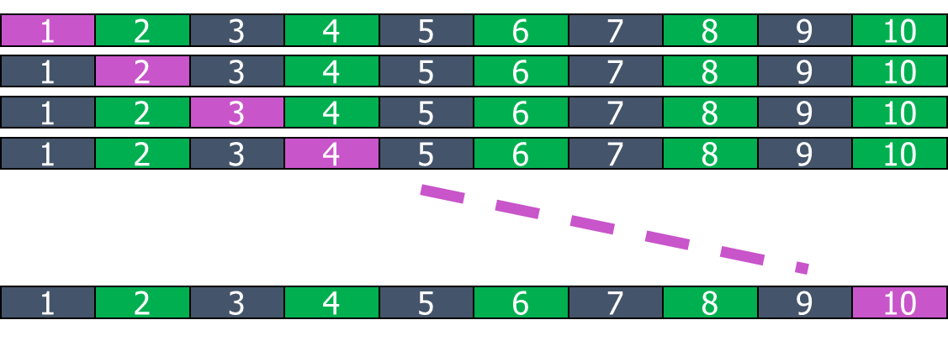
k-fold Cross-Validation
First step
dataset is split into k folds/partitions of equal size. Often 10 folds used
Second step
each fold used as test set; remainder for training
Calculate metrics over k folds

Slide 23
Standard Cross-Validation
Stratified ten-fold cross-validation
Ten-fold is known to give accurate estimate
9/10ths for training and 1/10th for testing x 10 (one per fold)
Stratification - each class is properly represented in each fold
“Properly” = in the same proportion as in the dataset
Repeated stratified cross-validation
E.g. ten-fold cross-validation repeated 3 times
Results averaged over 30 experiments (10 folds x 3 repetitions)
At each repetition, fold membership will change.
Can be computationally expensive
Reduces the variance

Slide 24
Leave-One-Out Testing
A particular form of cross-validation
number of folds = number of training instances
no random sampling involved
stratification is not possible
only one instance in the test set!
Makes maximum use of the data
test sets contain single instances
classifier is built n times when n training instances
n-1 instances in each training set
Very computationally expensive
Particularly for model builders
So best for small datasets

Slide 25
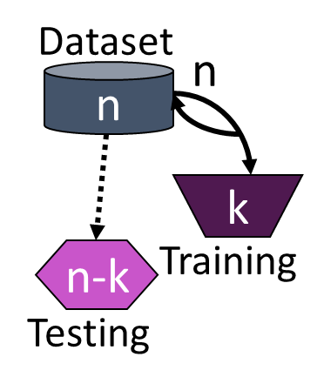
Bootstrap Estimation
Both Holdout and Cross-validation creates sample without replacement
instance cannot be selected again for testing
i.e. duplicates not allowed in training set
Bootstrap uses sampling with replacement to form training set
n instance dataset is sampled n times with replacement for new dataset of n instances
new dataset is training set
instances from old dataset not in new training set are used for testing – out of bag sample
training set has only ~63.2% of dataset in it

Slide 26
… bootstrap Estimation
Estimates on test data (holdout) can be very pessimistic
trained on only ~63.2% of instances
compared to 90% with 10-fold CV
Combine with resubstitution (training set) error
Error = 0.632 * error_{test} + 0.368 * error_{training}
resubstitution error weight < test data error weight
Repeat experiments several times with different selections for training data
average results
Good way to estimate performance for very small datasets - but some disadvantages

Slide 27
Other
When comparing models
The statistical significance of the difference in results needs to be assessed.
Calculate/plot confidence intervals:
if the intervals overlap: the difference in results is not statistically significant
If the intervals do not overlap, the difference in results is statistically significant.
E.g. comparing accuracies, the model with the highest accuracy can be said to better in terms of accuracy only if the confidence intervals do NOT overlap.
The experimental design (e.g. 10-fold cross validation) should normally be the same for a fair comparison. Also use the same data partitions.
Compare various aspects, e.g. :
Confusion matrices – where are the errors?
Tree sizes (if applicable)
Is the model easy to understand?
Performance time for new predictions
Model building time if model requires frequent re-building with new data.

Slide 28
Contents
Predictive model evaluation
Classification metrics
Experimental design
Clustering evaluation
Association rules evaluation

Slide 29
Evaluating cluster quality
Good clustering if
High-level similarity within each cluster – high cohesion
Low within cluster sum of squares (WC)
Long distance between clusters – high separation
Sum of distances between clusters (BC) is high
Combination of cohesion and separation
BC/WC - good indicator of overall quality.
But also number of clusters – trade-off between cohesion and the number of clusters.

Slide 30
Clustering – how many clusters?
In labs you have seen two measures which are used to determine the optimal number of clusters:
Within clusters sum of squares – uses cohesion.
Silhouette – uses separation and cohesion.
What is the distribution of instances in clusters?
Is there any cluster with virtually no instances?
Is there any cluster with most instances?

Slide 31
Discussion
Evaluation of clustering
Often by inspection - do the clusters “make sense”?
Clusters can be visualised if low dimensionality
“Classes to clusters” – known class values vs clusters.
Need a class attribute (used only for evaluation) to check if cluster members share the class value
Interpretation of clusters
Supervised learning in a post-processing step
Training data is clustered data labelled by cluster id
Decision tree or rule-set inferred to predict cluster

Slide 32
Contents
Predictive model evaluation
Classification metrics
Experimental design
Clustering evaluation
Association rules evaluation

Slide 33
Association rule measures
Support (coverage) applies to an itemset - set of items which appear together in a number of instances
Proportion of instances where all the items in an itemset appear together
Confidence (accuracy) – applies to a rule
It is the accuracy of the rule, i.e. the proportion of instances where the rule is true out of the number of times when the rule is applicable.
Lift - The ratio of the observed support to that expected if rule condition and conclusion were independent.
The rise (or decrease) in probability of the conclusion of the rule being true if we have observed that the condition of the rule is true.
1 if condition (LHS) and conclusion (RHS) are independent.
> 1 if presence of condition makes conclusion more likely.
< 1 if presence of condition makes conclusion less likely.

Slide 34
Association rule interpretation
Rule overall rating depends on
Support, confidence and lift
The usefulness of the rule
Rule usefulness
Some rules may have high support, confidence and lift but be of little use
Other rules may have lower values for the metrics, but be more useful.

Slide 35
Summary
Different evaluation methods are used for different types of data mining algorithms.
Predictive model evaluation
Classification: accuracy, kappa, precision, recall, specificity, sensitivity.
Regression: mean absolute error, mean squared error, root mean squared error, R-squared, adjusted R-squared.
Clustering evaluation: cohesion and separation for quality of clusters, but visual inspection or classification algorithm applied to learn what the clusters mean to check that clusters make sense.
Association rules evaluation; support, confidence, lift.
In all cases, the usefulness of the findings should be assessed as well as any bias.

